Slide 2
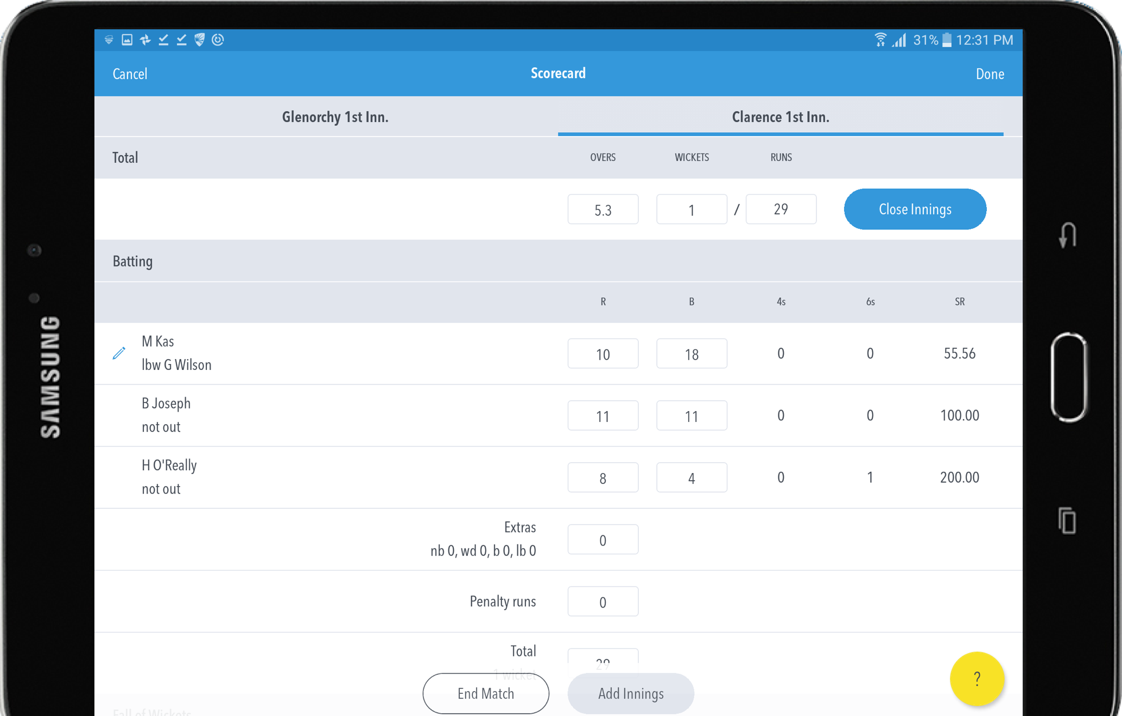
New FREE MyCricket Live Score App
Search for “MyCricket Live Score” in the App store
Available on all smart phones and tablets (iOS and Android)
Major part of the revamped MyCricket and Grassroots rebuild

Slide 3
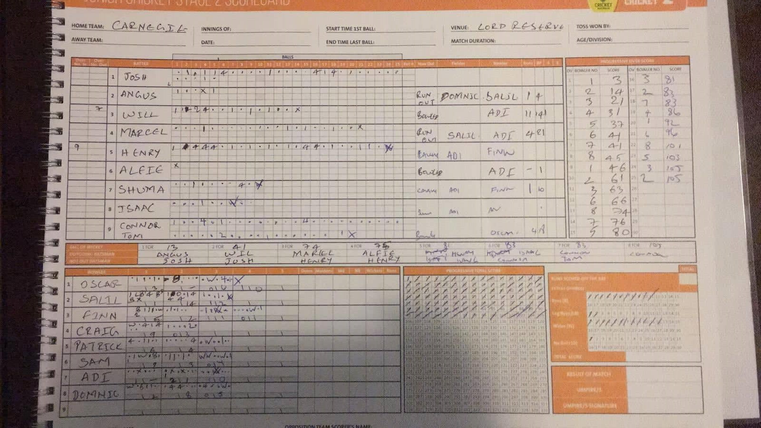
Junior Scorers in the House???

Slide 4
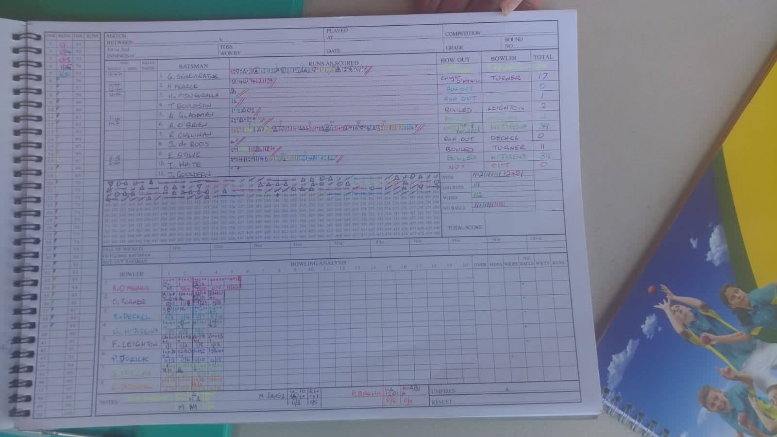
Senior Scorers in the House???

Slide 5
MyCricket
Entering Scores on MyCricket???

Slide 6
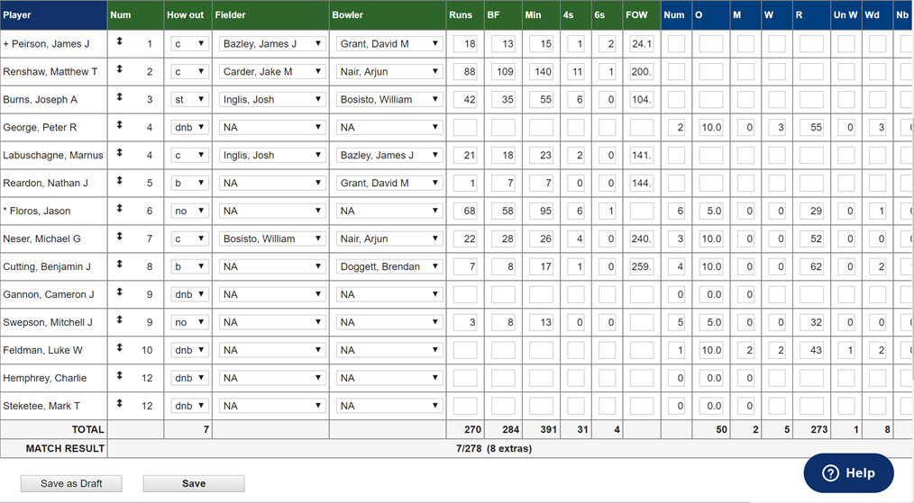

Slide 7
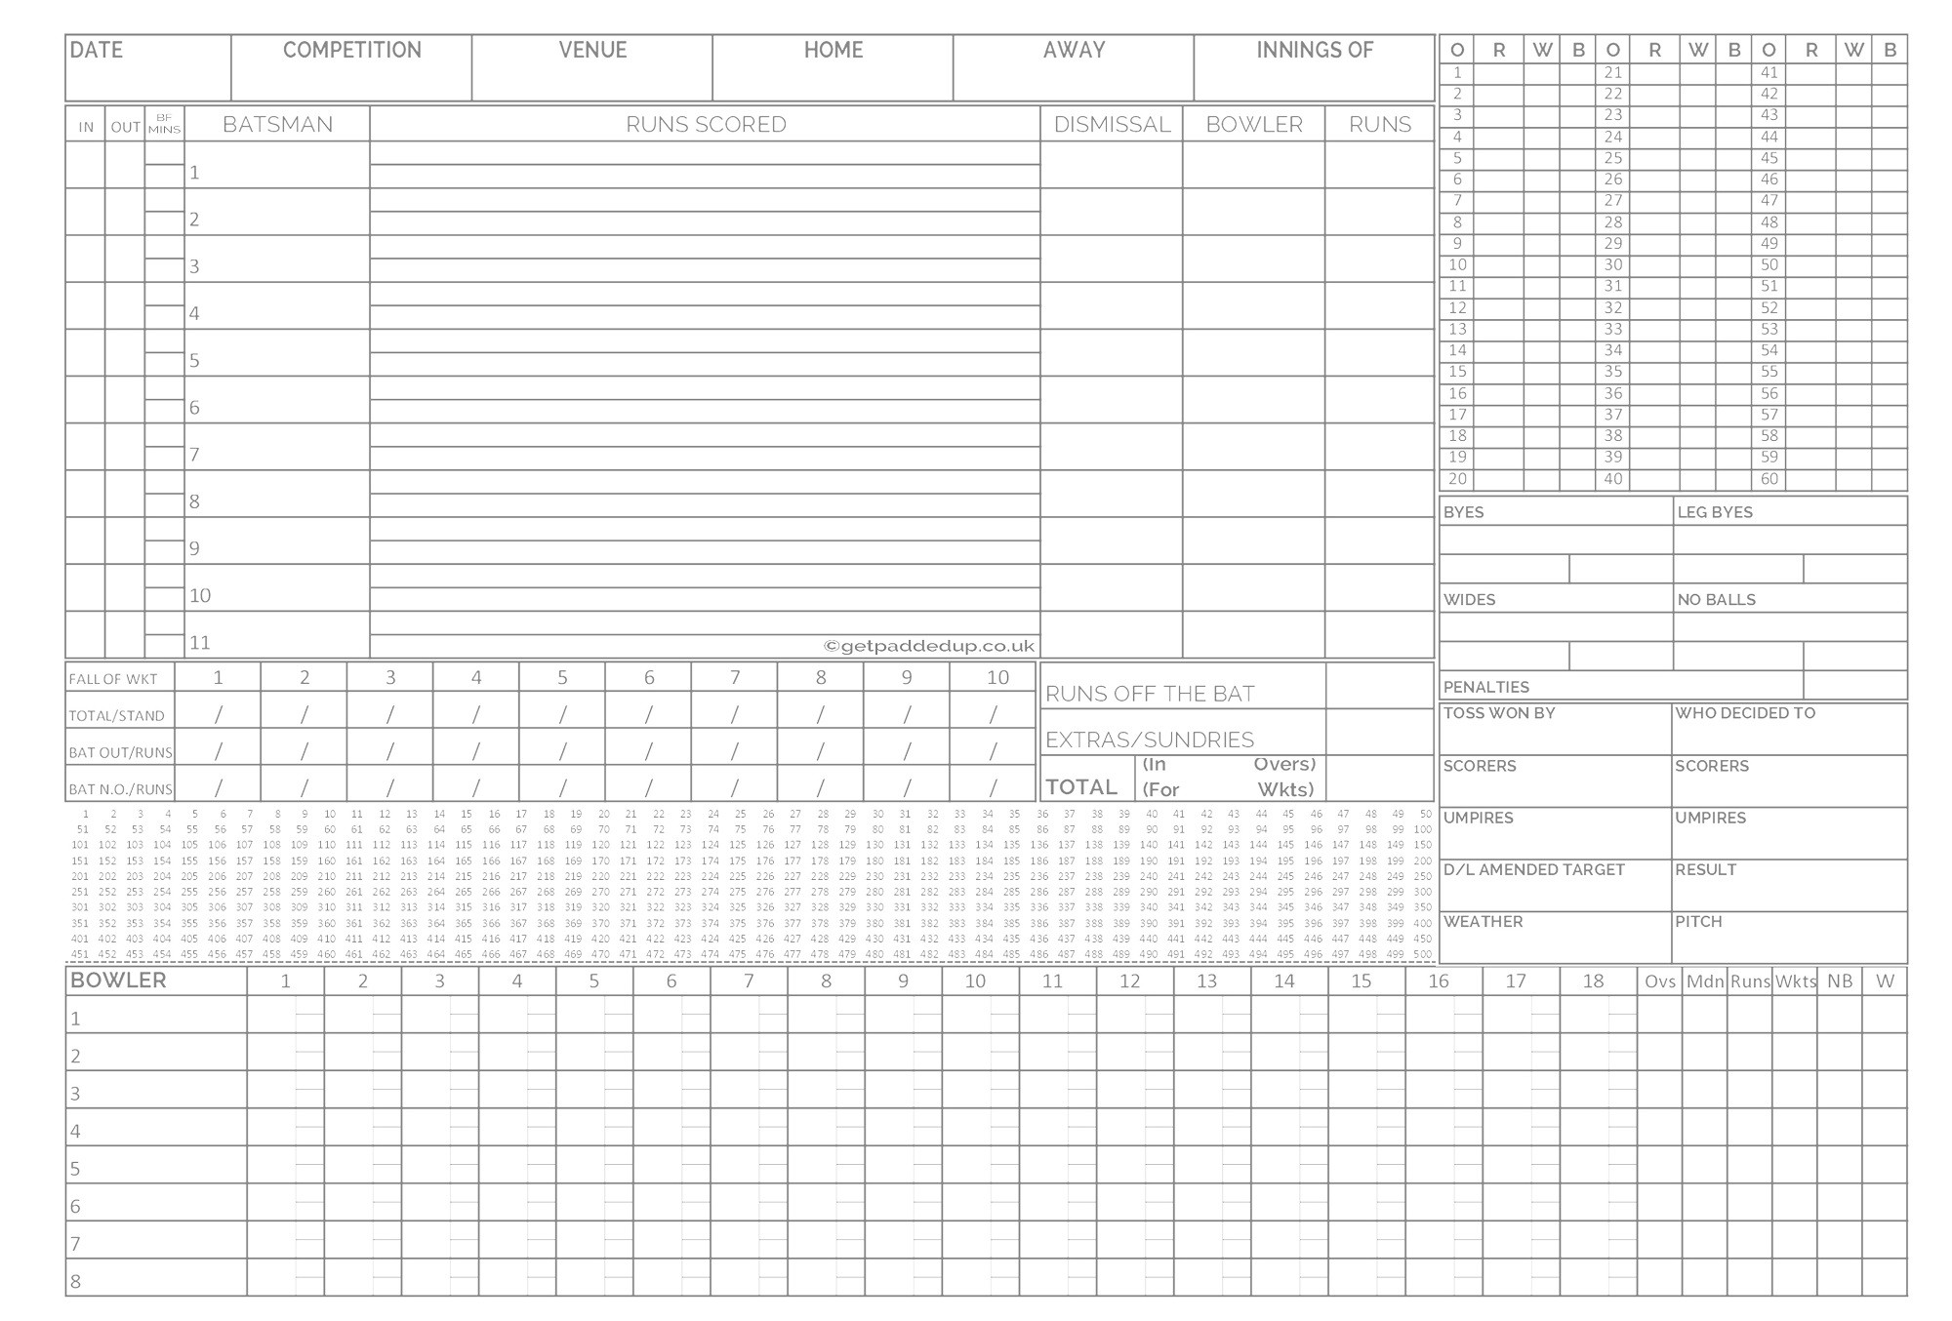
TRADITIONAL SCOREBOOK
Complex and cluttered scoring interface.
Record every ball in at least 3 or 4 areas (Batsman, Extras, Bowler, progressive Scorecard)
All information to be manually filled.
Need to be conscious of entering the score against the batter in strike.
Need to re-enter the entire Scorecard onto MyCricket at the end of the game.

Slide 8
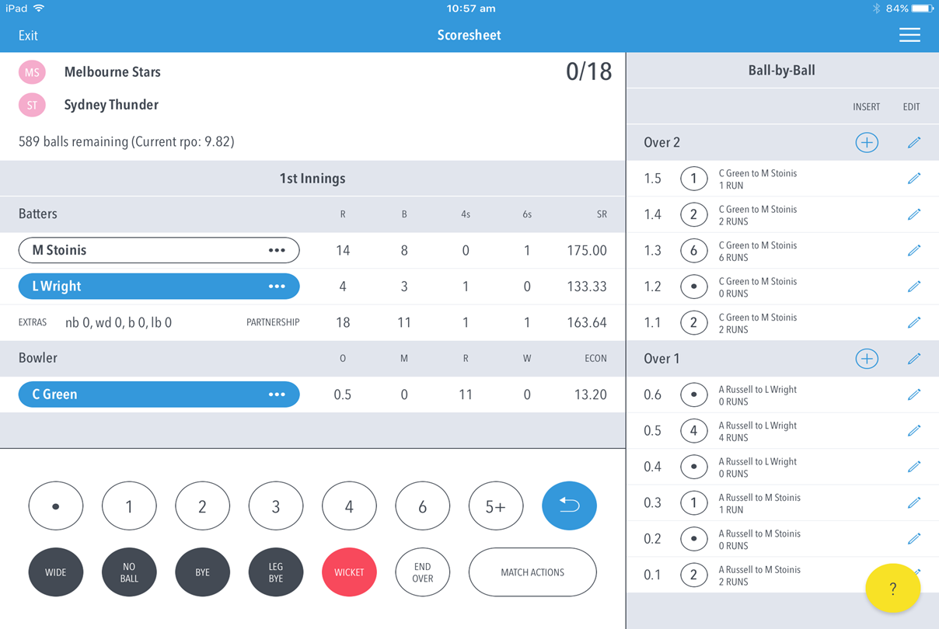
Scoring Interface – MyCricket Live score App
Clean and Easy Scoring interface.
Just click 1 button (1,2,3,4,6 etc.) & Follow messages where required (eg. Wicket)
Majority of the sections are automatically populated (balls faced, scorecard, etc.)
Batter automatically change strike (eg. Single, end of over etc.)
Scorecard syncs to MyCricket. No need to enter full scorecard.

Slide 9
Entering Player Scores – Automatically captured and recorded while using MyCricket Live Score App

Slide 10
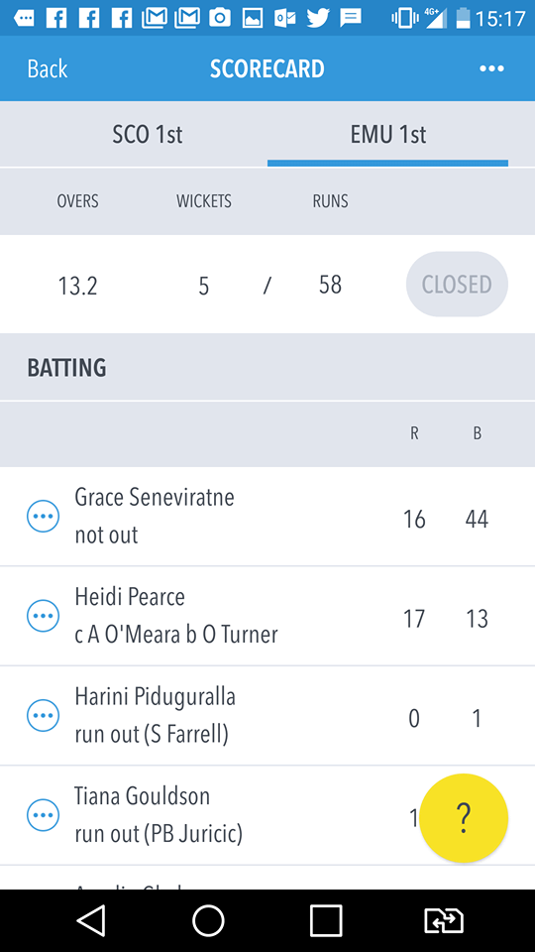
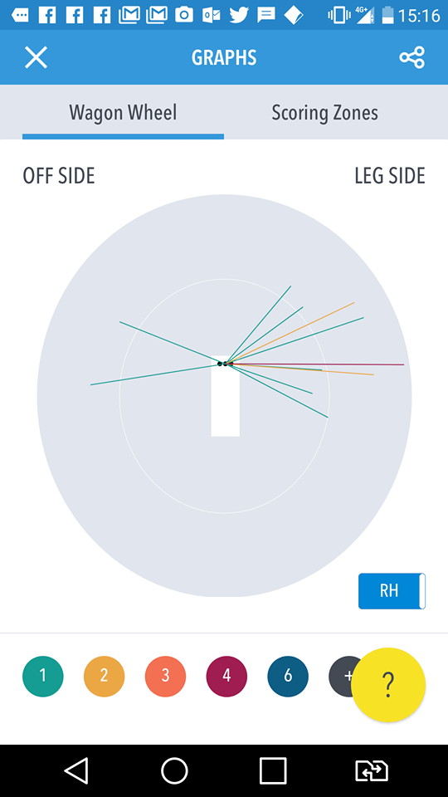

Slide 11
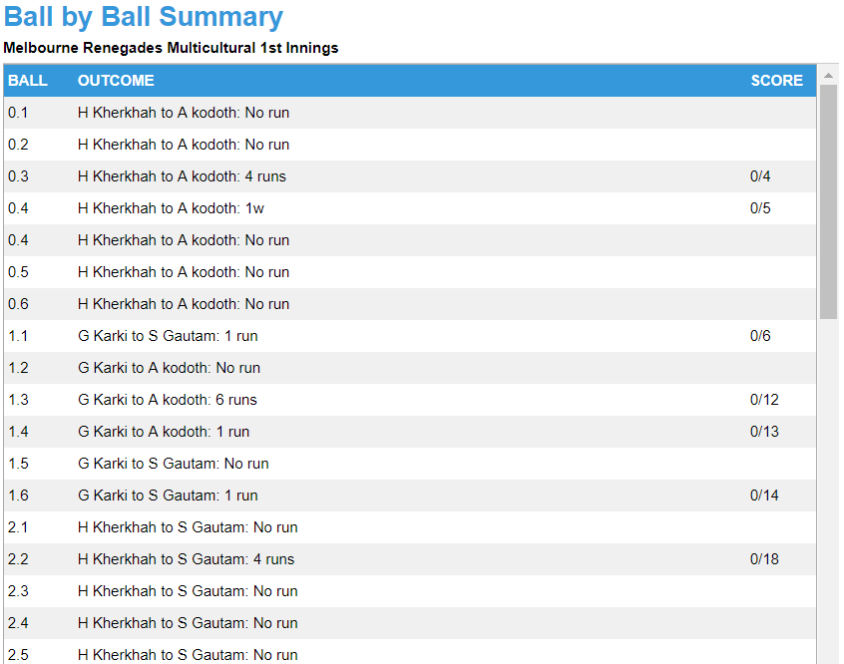
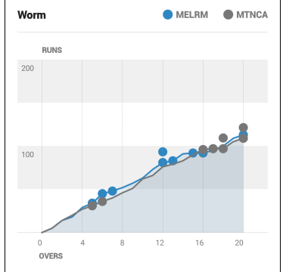
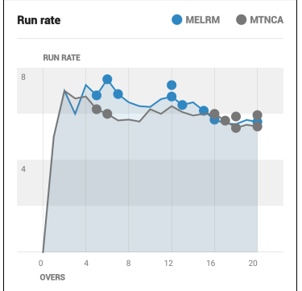

Slide 12
MyCricket Live Score App – Benefits & Features
Available and FREE on any smart phone or tablet device
User friendly for scorers of all levels / experience
Fully compatible with CA Junior Formats
No Need to Enter Full Scorecards and results onto MyCricket
Enhanced Reporting – Wagon Wheels, Ball by Ball Commentary
Add ‘Unknown’ Player or ‘Substitute’ Player
Low data & battery consumption
Split Innings
Duckworth Lewis system

Slide 13
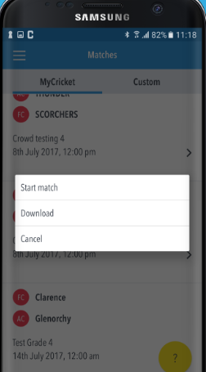
Online vs. Offline
A common thought is you must be online to use the Live Score App – this is FALSE
Scorers only need to be online at two points, and both can be done at home either side of the game:
Login to the Scorer App and download your match
Sync any results from the App to MyCricket
All scoring can be done offline and will remain within the App until you sync the results.
Testing showed most scoring could be done in a day without the need of a battery pack (limit use of other apps though)
The App uses approx. 500KB of data per 80 overs

Slide 14
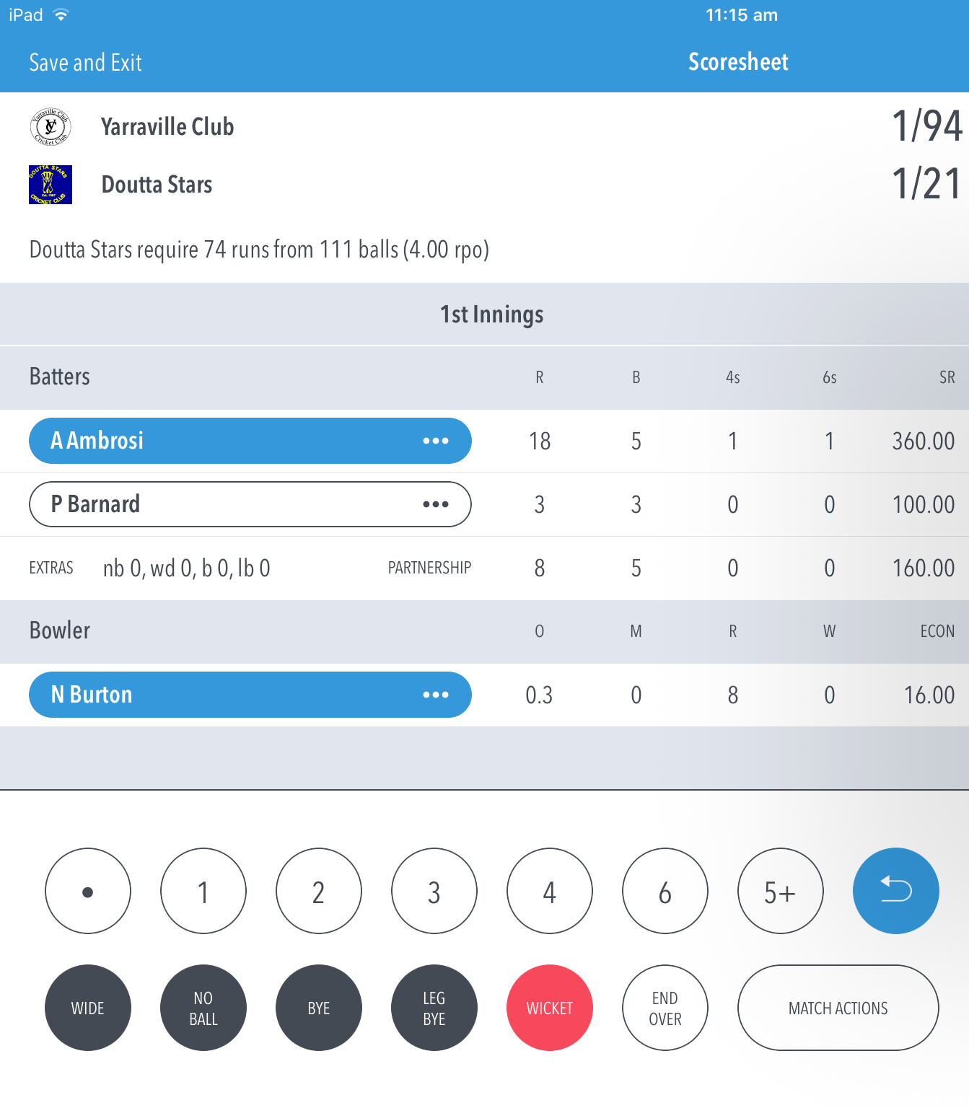
Scoring from Multiple Devices
Locking and unlocking matches
Scorers from both teams are welcome to use the MyCricket Live Scorer App together on two devices … however only one should be syncing results
When exiting a match for now you will be prompted to either lock or unlock the match for another user

Slide 15
Admin Tasks
The MyCricket Live Score App talks directly to the MyCricket Admin site
Users will need a MyCricket login created by their club / association with Person and Results Manager access.
Essential that players are active in your club, and registered to the association for MyCricket Live App to work best
The Association will create fixtures and set initial formats (eg. One Day 50 over match, Junior Formats, 2 day match)
Recommend selecting teams / squads via the Admin site prior to the match where possible.
Still recommend keeping a scorebook (2 scorers per game)
If using the MyCricket Live Score App the Admin site becomes a check and confirm process only

Slide 16
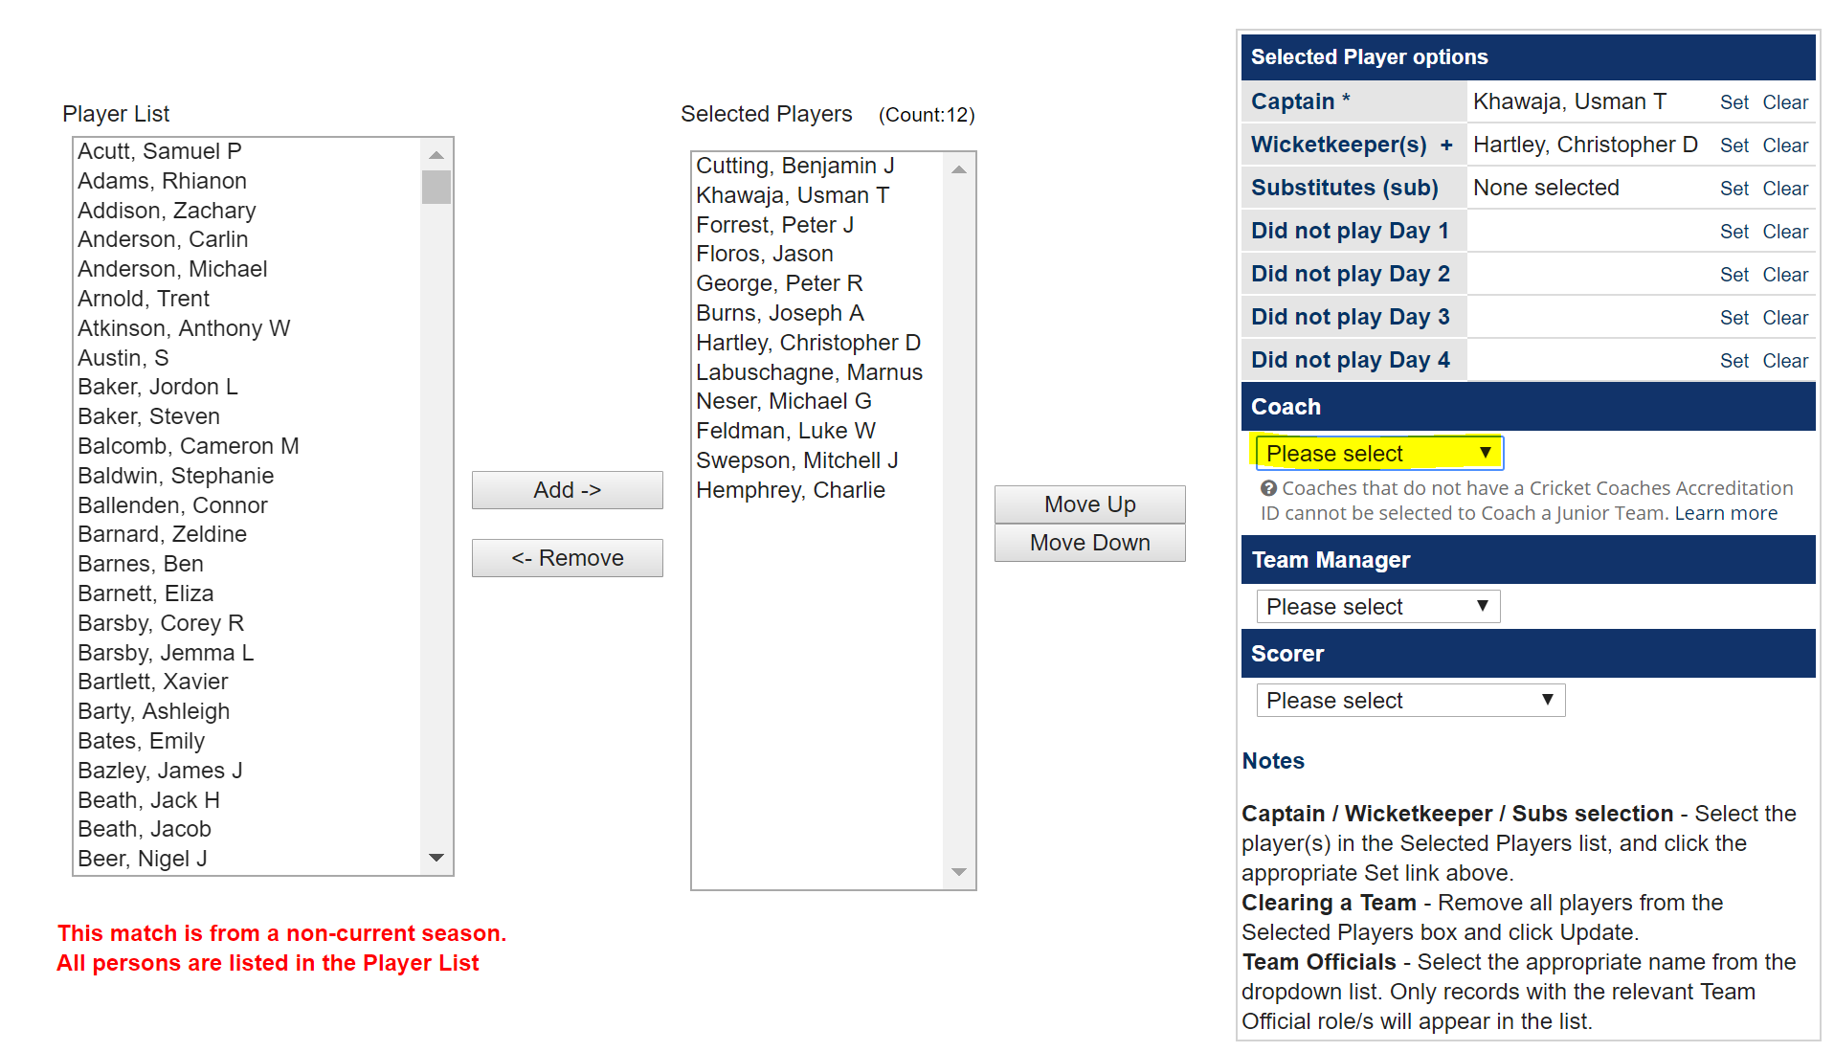
MyCricket Admin Website
MyCricket Administration site – use this to set everything up, and use the same Login details you’ve got from your club. All tasks in the TEAMS Tab.
TEAMS Tab … Matches -> Select Team

Slide 17
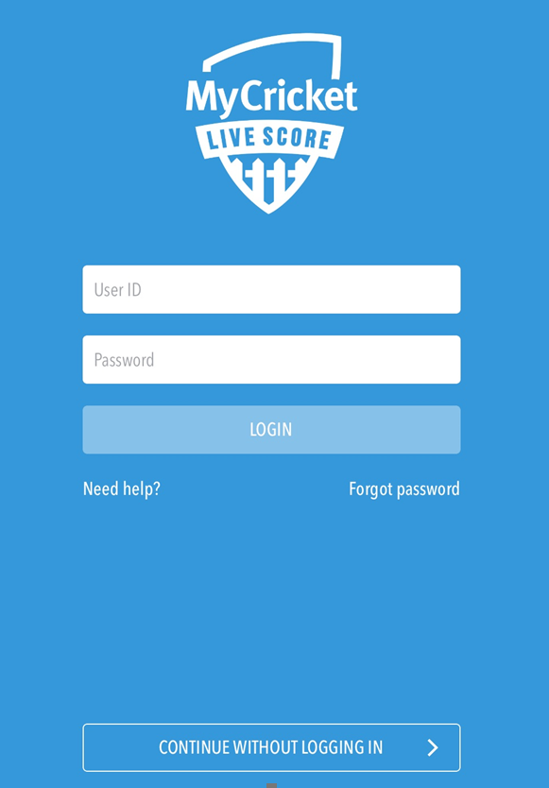
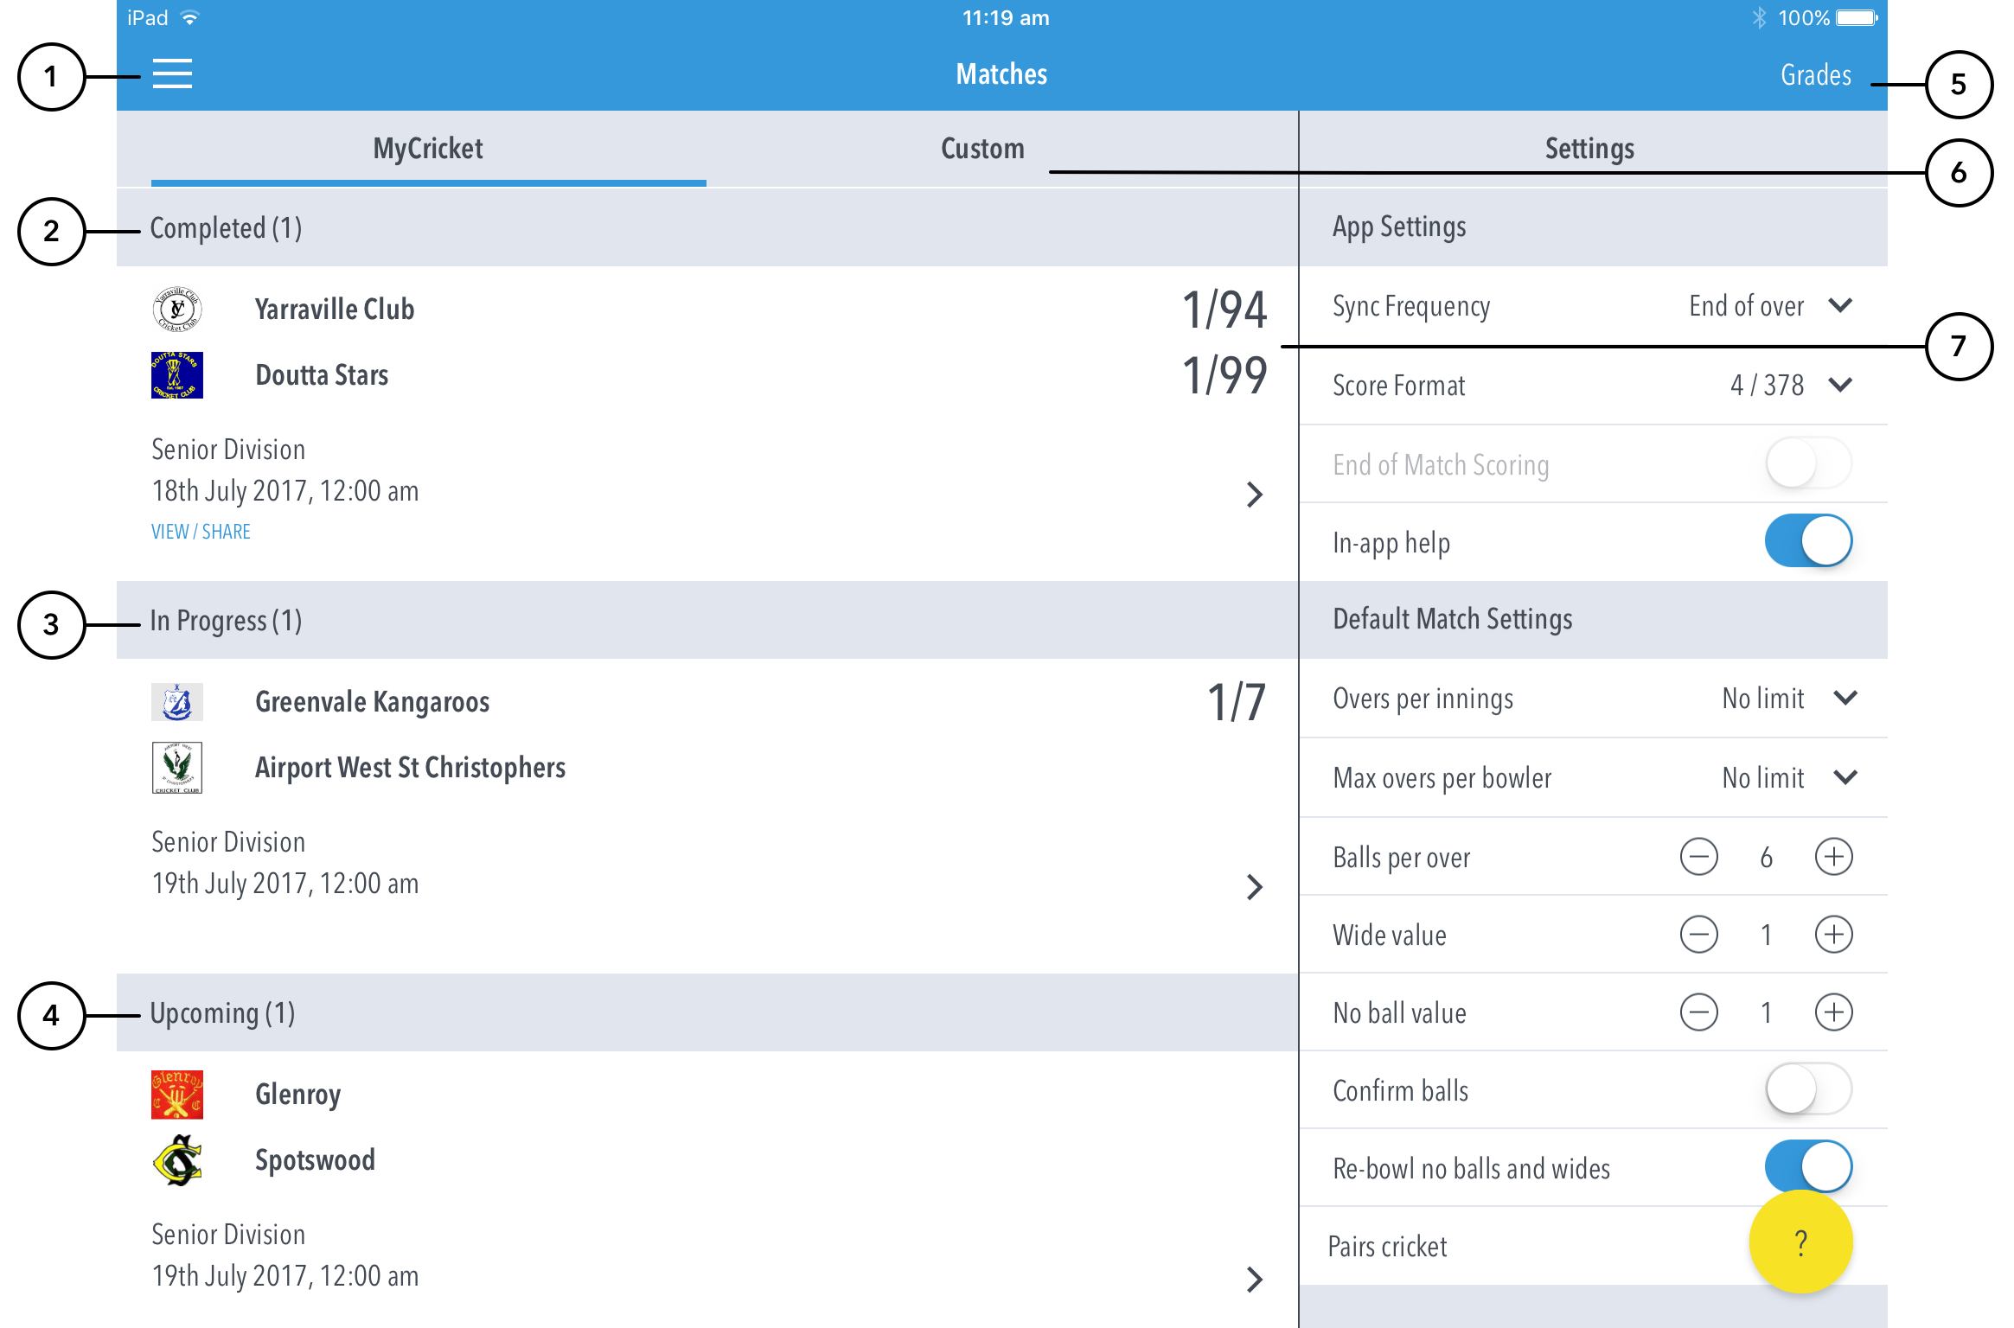
Match Set Up – GAME DAY
Login using your credentials and adjust the settings on your right.

Slide 18
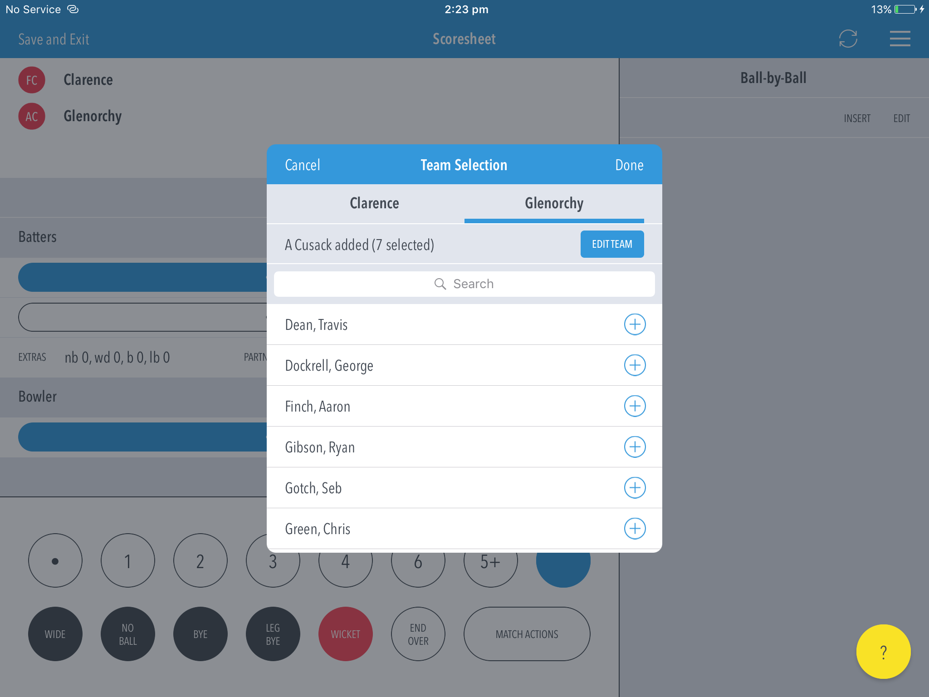
Team Selection
Next step after Match Settings … ensure all players are Registered to the Association.
You can create new players within the App.

Slide 19
Scoring
All Scoring and ball-by-ball editing happens on this screen.

Slide 20
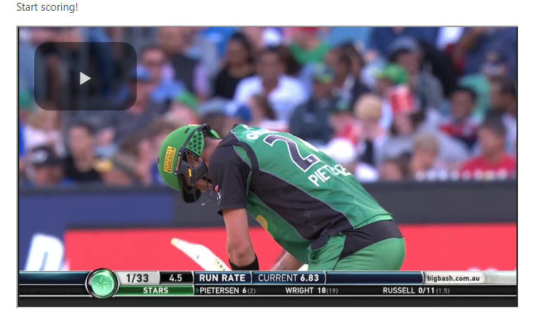
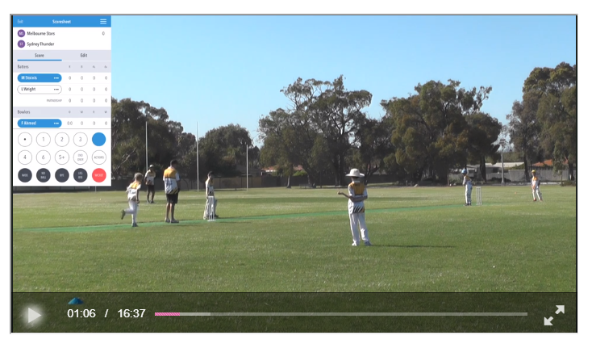

Slide 21
Demo Match
The MyCricket Live Score App includes a pre-loaded Demo Match with match footage on the CA Support website.
Open the App and “continue without logging in” to the demo match … 20 overs per innings with 4 per bowler.
Thunder won the toss and bowled … Score ball-by-ball
Strike batter – Stoinis
Non-strike batter – Wright
Bowler – Russell
Demo Match – Click Here
Support Site – Click Here
We’ll score a few overs from the footage then discuss Scoring Scenarios

Slide 22
Scoring Scenarios
Scoring Scenario | How to Score in the App
Change Strike Batter (without affecting stats) – Happens when the scorer has the wrong batsman on strike (usually after a runout if they have got the cross over wrong) | Select the batter and press change strike
Change Batter – Usually happens when batter retires due to injury or having faced quota of balls (junior cricket) | Select the batter and press change batsman and follow messages (retired batter, injury, scoring errors, change strike)
Wicket | select red WICKET button and follow messages. (Do not panic if you have got certain details wrong (like fielder name). It can be edited in view/edit scorecard later)
Undo Last Ball – (If scorer makes an error with previous ball) | Blue symbol next to 5+
Runs off NB / Wides | Select the extra then the additional runs, and confirm via the messages
Wide + Runs | Select WIDE and then TOTAL Runs of the ball - If batsmen have run 2 runs of a wide – Select WIDE and “3” (1 for the wide and 2 for the runs taken). In some cases the app will ask how the extra should be recorded (Eg. Wide + 4 runs or 4 wides?) – Select the appropriate option.
No Ball + Runs | Select No Ball and then select number of runs the batter scored. (In some cases the app will ask how the extra should be recorded (Eg. NoBall + 4 runs or No Ball + 3 runs?) – Select the appropriate option.

Slide 23
Scoring Scenarios
Scoring Scenario | How to Score in the App
Wicket off W / NB | Select the EXTRA first, then Wicket and confirm via messages
Penalty Runs | Select 5+ and follow the messages - Whether Penalty runs awarded to Batting team (eg. Hit the helmet placed behind keeper) or Bowling team (eg. Misconduct by Batter)
View Scorecard | Select View/Edit Scorecard from Top right corner (menu button), and use this to view/edit full scorecards
Change Bowler – Usually happens when bowler retires due to injury or has been taken out of the attack (2+ beamers/ running in danger area) OR when the scorer has made an error (eg. Did not see change of bowler and started recording the over against the wrong bowler) | Select the bowler and follow messages: Change for reminder of over (usually when taken out of the attack or due to injury) Change for the entire over (Usually due to scorer error)
One Short | If you have incorrectly scored the ball before the umpires signal, select Undo button and then select actual number of runs scored and change strike to get the correct batter on strike. If not, just select actual number of runs scored and change strike to get the correct batter on strike.
Run Out (+ Runs taken) – when run out trying to take 2nd or 3rd run | Select Wicket – Follow prompts for run out then just before confirming add runs scored. Alternatively, Select runs scored and then wicket and follow messages for Run Out
Over Throw | Select total runs Scored. If total runs > 5 select from 5+ (eg. Batters run 3 plus overthrow 4)

Slide 24
Scoring Scenarios summary
Refer to the iPad scoring screen
Change batter / bowler … select their name and follow the messages (retired batsmen, injury, scoring errors, change strike)
Wicket … select red WICKET button and follow messages
Undo Last Ball – Blue symbol next to 5+
Penalty Runs – Select 5+ and follow the messages
Runs off NB / Wides – Select the extra then the additional runs, and confirm via the messages
Wicket off W / NB … select the Extra first, then Wicket
Editing – Use the pencil symbol next to the ball / over to edit
View Scorecard – Top right corner, and use this to edit full scorecards (including catchers)
Confirm balls on / off … Export Scorecard to PDF
End Match – Follow the prompts from the Live Score App

Slide 25
MyCricket Live Score App – Features Summary
Features:
Available and FREE on any smart phone or tablet device
User friendly for scorers of all levels / experience
Don’t need to be online to score the match
Fully compatible with CA Junior Formats
Recommend keeping a run sheet or modified scorebook
Add ‘Unknown’ Player or ‘Substitute’ Player
Enhanced Reporting – Wagon Wheels, Ball by Ball Commentary
Low data & battery consumption

Slide 26
MyCricket Live Score Tips
To assist with scoring at your match you may want to consider the tips below
Select teams before beginning the match within the app
Ensure device is fully charged & reduce brightness of screen
You can only sync the match from one device at a time, but you can score on two devices
‘Save and Unlock’ match if you are switching devices or scorers (ie: 1st innings scored on iPad, 2nd innings scored on Android Mobile)
Matches appear in ‘Upcoming Matches’ 2 days before they begin
Person Manager & Results Manager MyCricket User Role are needed to score a match
Check the MyCricket App or Websites to ensure scores are syncing (optional)
Wagon Wheels and Confirmation of balls are optional

Slide 27
Thanks!!
Questions and Feedback??

